Slide 1


HOUSEKEEPER SCHEDULING SYSTEM
Get Your Rooms Cleaned at your time with just a Click!

Slide 2





TEAM MEMBERS
K.TEJA SHANTI KUMAR
2580228
KOVVURI SAI SUDHA
2580217
MAHAMMAD SHAHEDA
2579690
MANORANJAN MALLICK
2580166

Slide 3




TEAM MEMBERS
MUPPALA MONISH
2580159
MAYUR REDDY V
2579634
MUKULA TAPASVI
2580513
N.GOPI MANIKANTA
2579641

Slide 4

CONTENT
Abstract
Purpose
Modules
Technologies used
Project Architecture & Design
Snippets
Advantage
Conclusion

Slide 5

ABSTRACT
The Housekeeper Scheduling System is like a smart helper for managing housekeeping services. It's a user-friendly digital tool that makes scheduling tasks easy. Using smart technology, it helps to keep a track on housekeeping staff, tasks assigned by admin, and adjusts schedules based on staff availability and customer preferences. The goal is to make housekeeping more efficient, ensure tasks are done on time, and create a smooth experience for both service providers and customers.

Slide 6

PURPOSE
As a Team, the objective is to create a feature-rich online housekeeping scheduling system that aligns with the provided requirements and business model, offering a
seamless and intuitive experience for hostel students to
request and receive timely room cleaning services.

Slide 7
MODULES
1. Login and Register (Admin) – Mahammad Shaheda
To create admin account and to login to admin dashboard
2. Login and Register (User) – Muppala Monish
To create User account and to login to user dashboard
3. Dashboard/Navbar (Admin and User) – Manoranjan Mallick.
To access other modules and to navigate between modules.
4. Register New Housekeeper and Student (Admin)– Kovvuri Sai Sudha.
To register new housekeeper and new student in admin side.

Slide 8
MODULES
5. Feedback Module (Admin and User) – Mayur Reddy V
To get feedback from the user side.
6. Request to Clean (User) and Allocating housekeeper (Admin) – Teja Shanti Kumar
To allot housekeeper to the appropriate requests
7. Updating of profile and password (User) – Gopi Manikanta.
To update the existing details with new one.
8. Main Login page and logout – Mukula Tapasvi.
Navigating to student login and Admin login

Slide 9





TECHNOLOGIES USED
FRONT-END -Angular
SERVER-SIDE -Spring Boot, Hibernate
DATABASE -MySQL
TESTING - Postman & TestNG

Slide 10
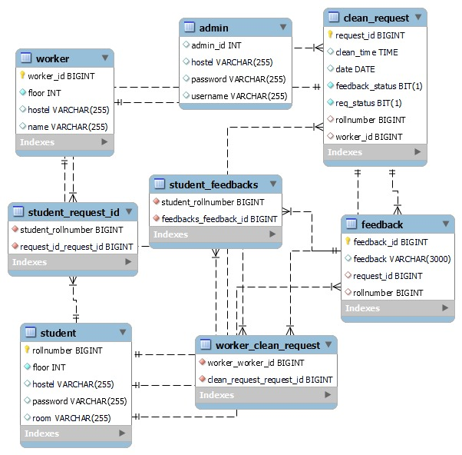
ER DIAGRAM

Slide 11
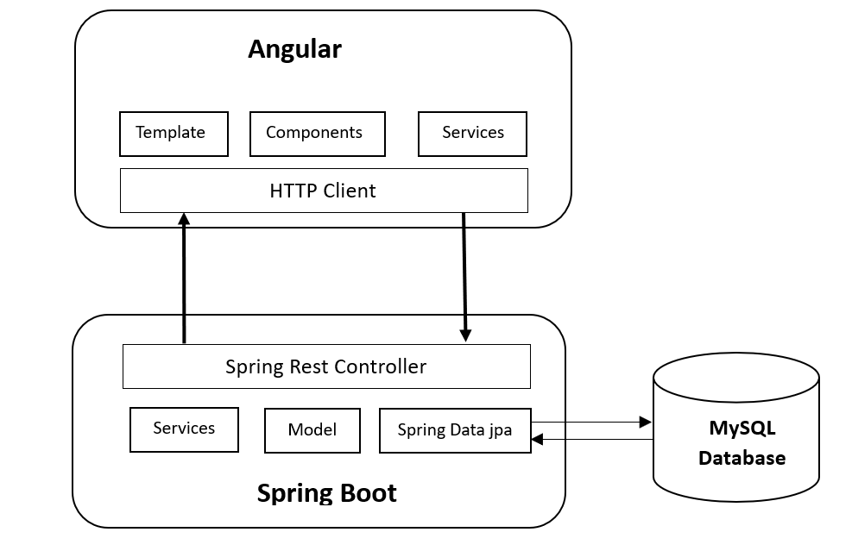
PROJECT ARCHITECTURE

Slide 12
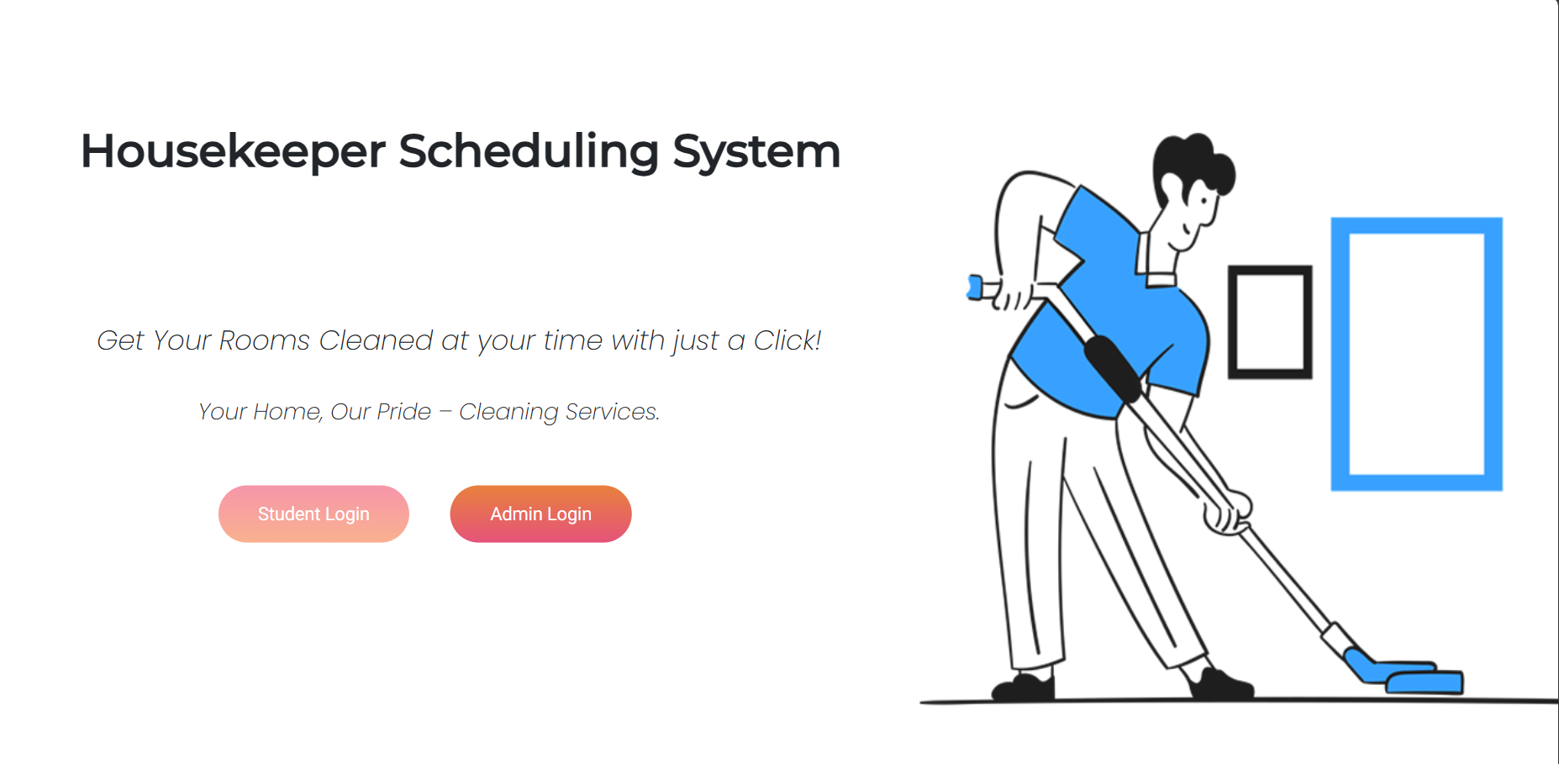
MAIN LOGIN

Slide 13
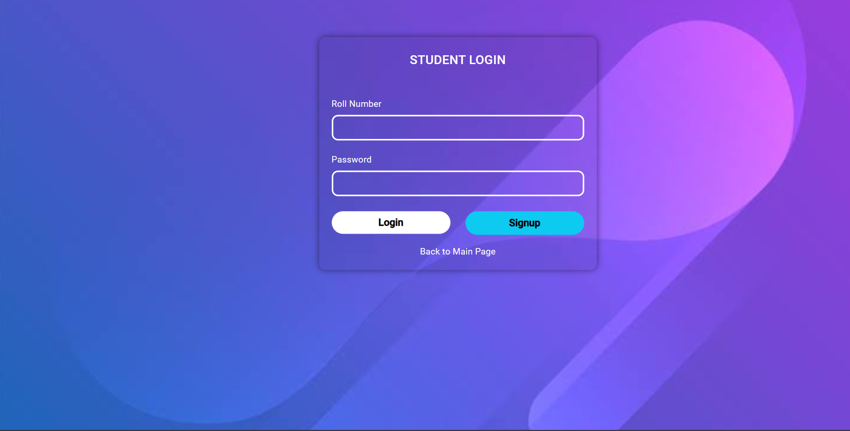
STUDENT LOGIN

Slide 14
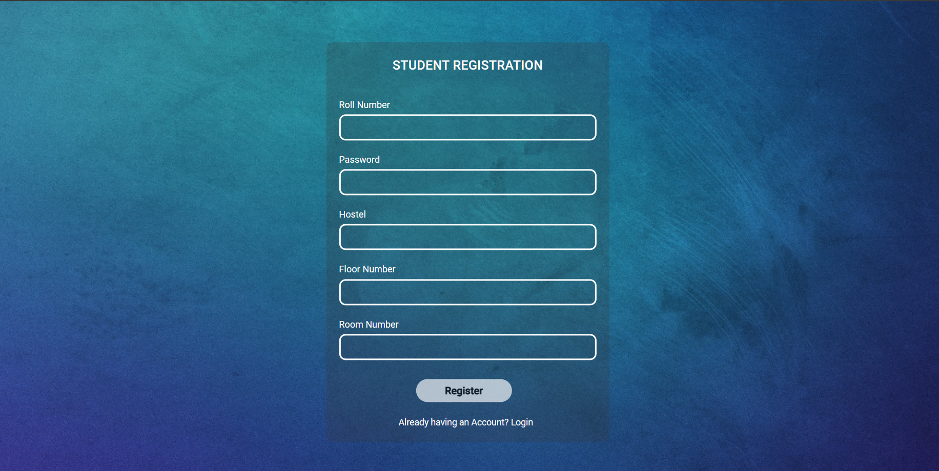
STUDENT REGISTRATION

Slide 15
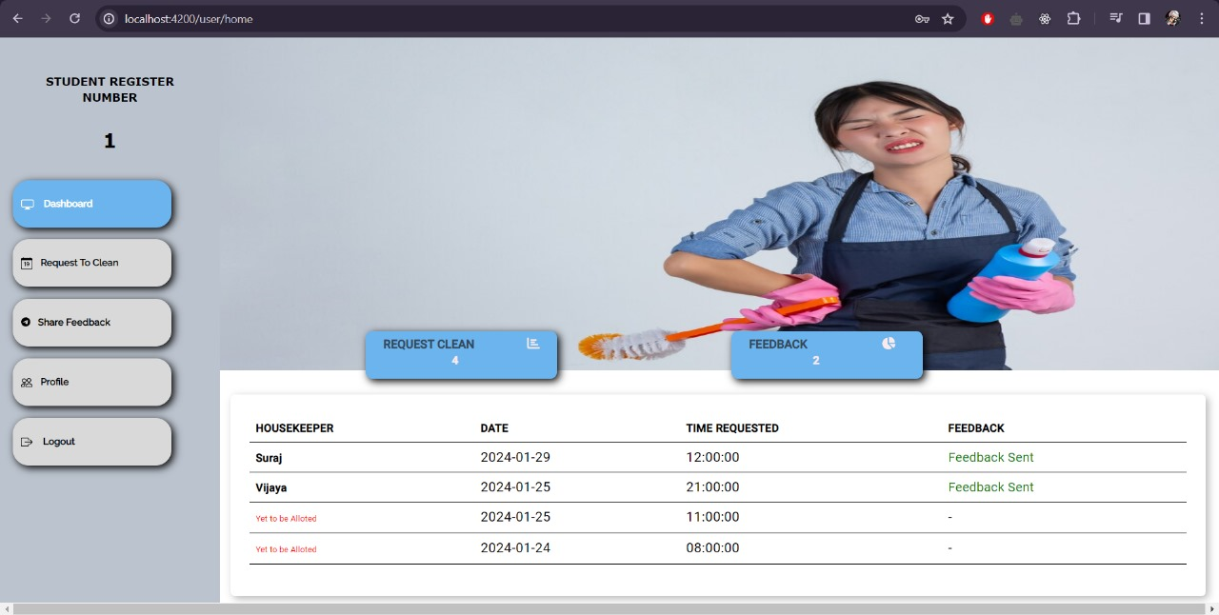
STUDENT DASHBOARD

Slide 16
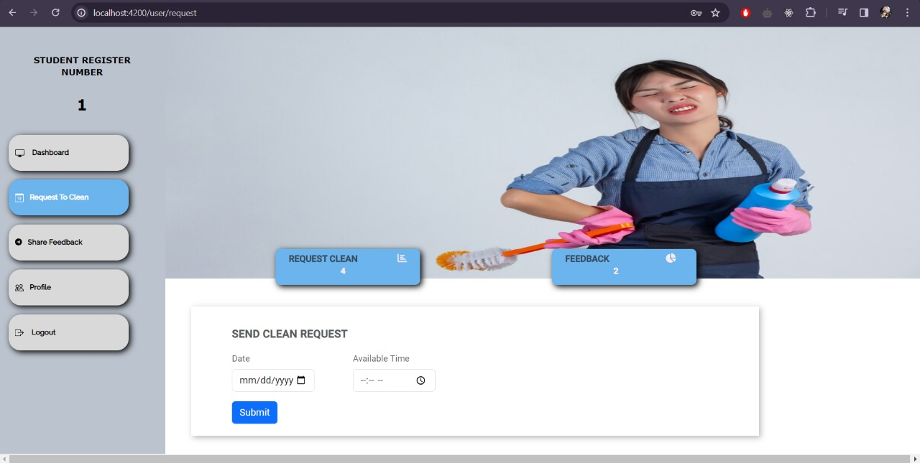
CLEAN REQUEST

Slide 17
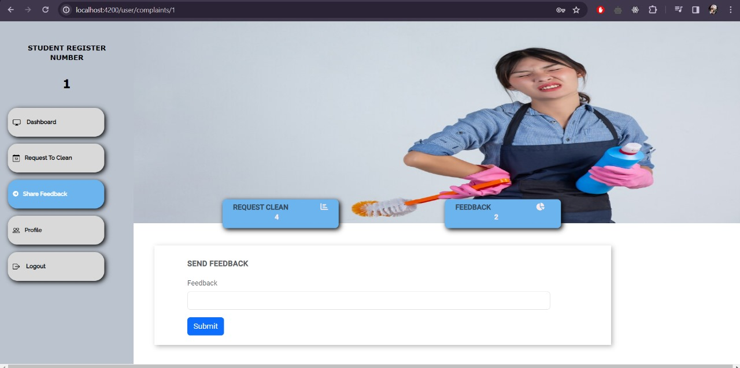
STUDENT FEEDBACK

Slide 18
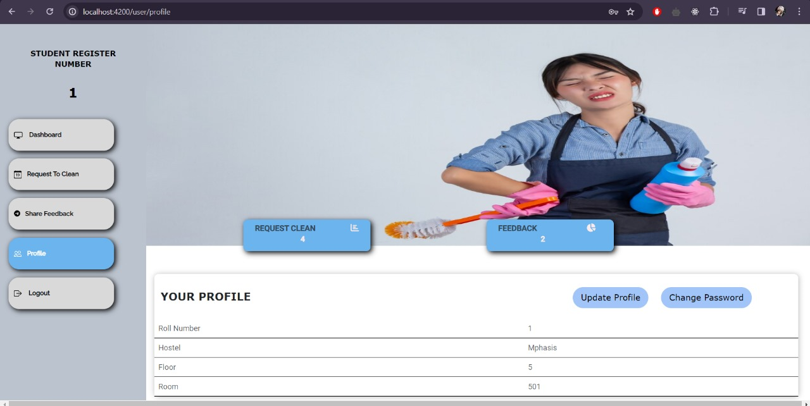
PROFILE PAGE

Slide 19
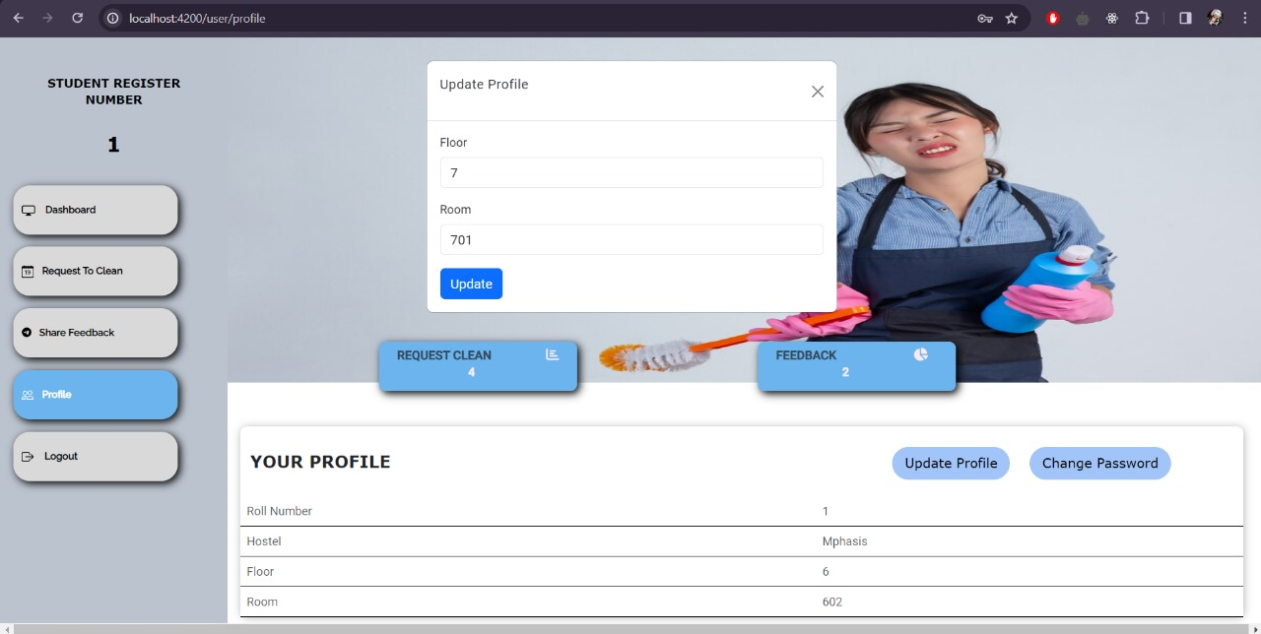
UPDATE PROFILE

Slide 20
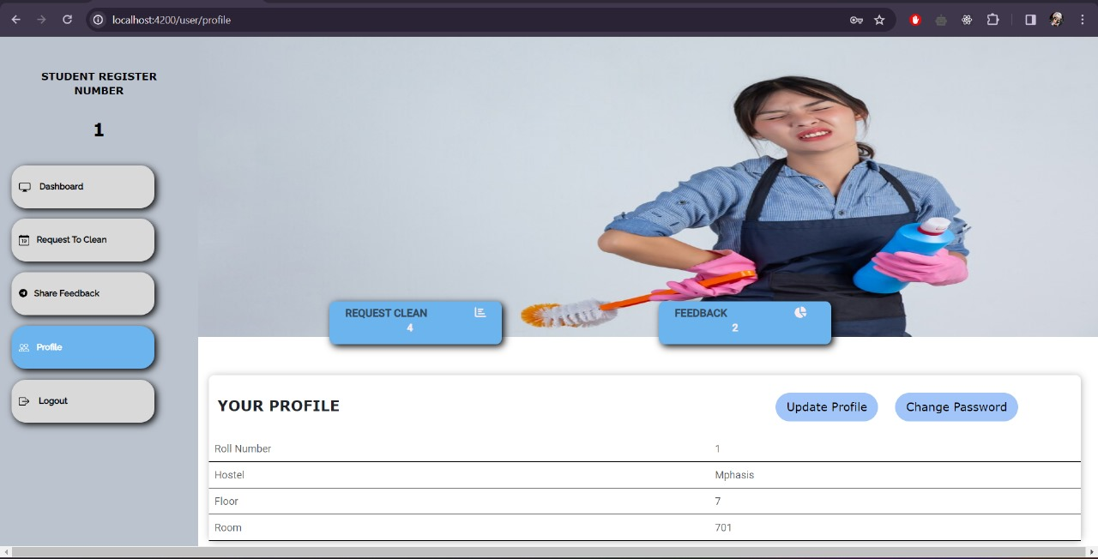
AFTER UPDATION

Slide 21
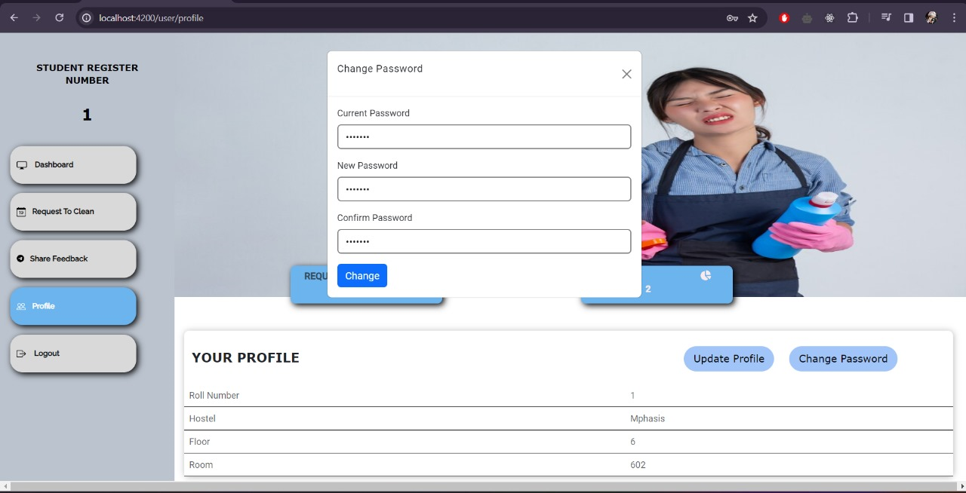
CHANGE PASSWORD

Slide 22
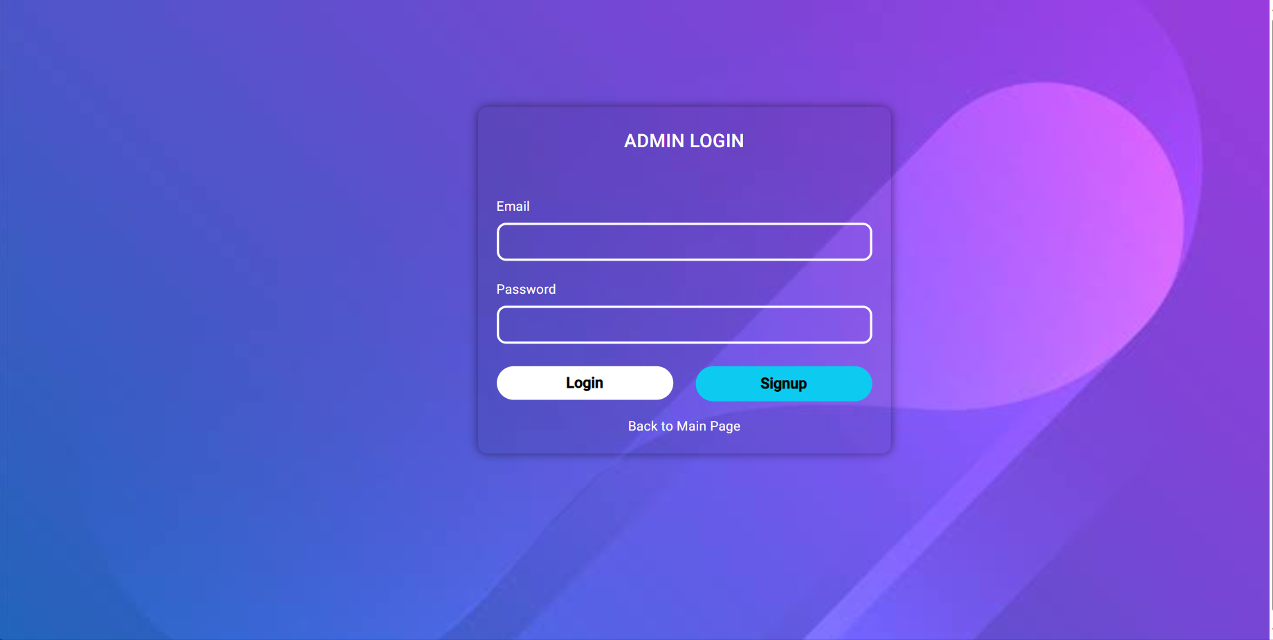
ADMIN LOGIN

Slide 23
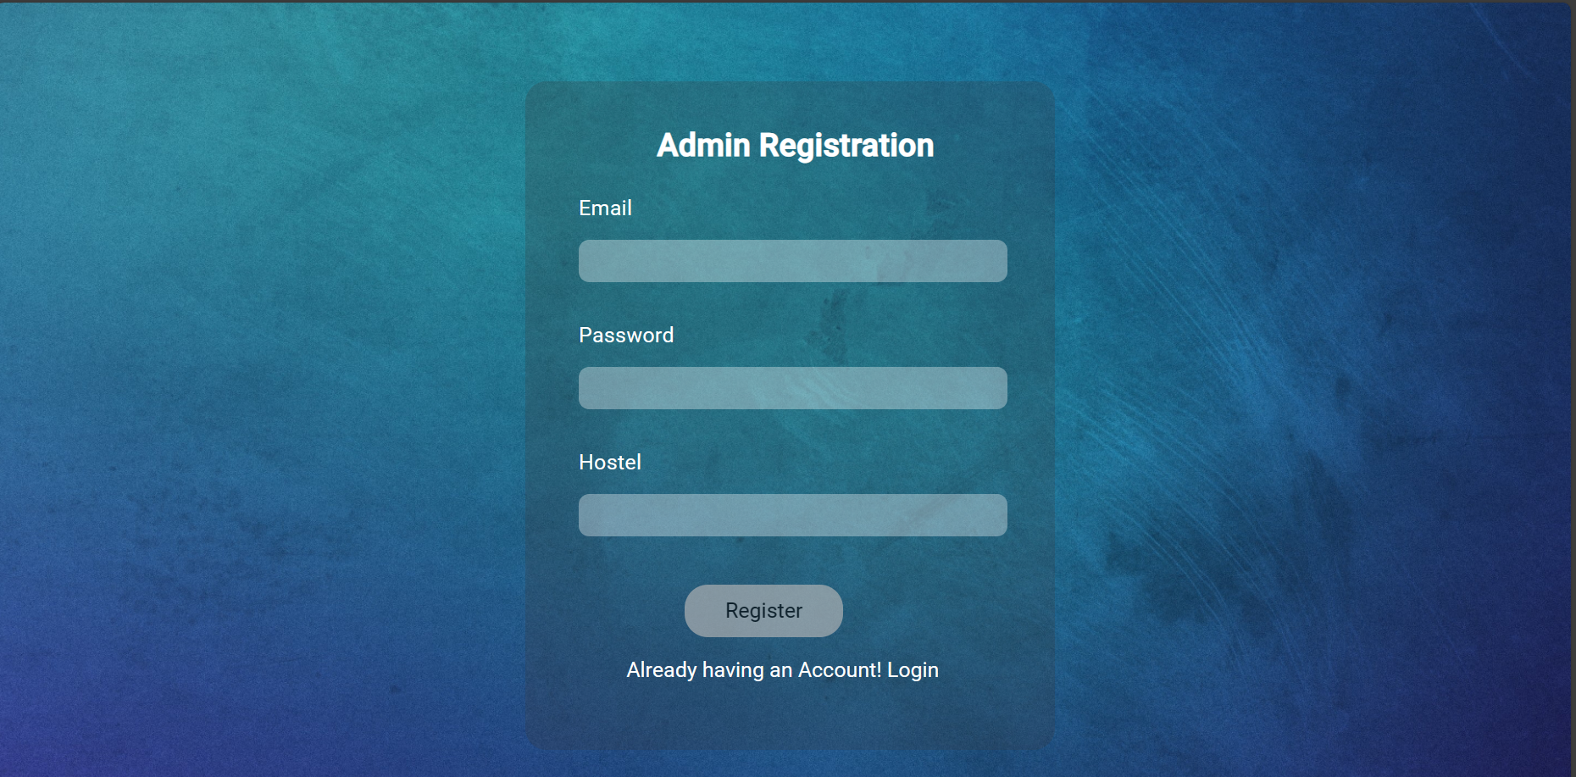
ADMIN REGISTRATION

Slide 24
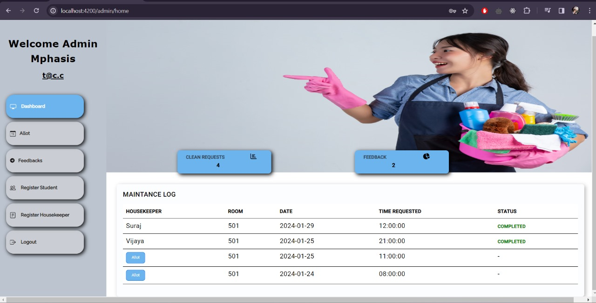
ADMIN DASHBOARD

Slide 25
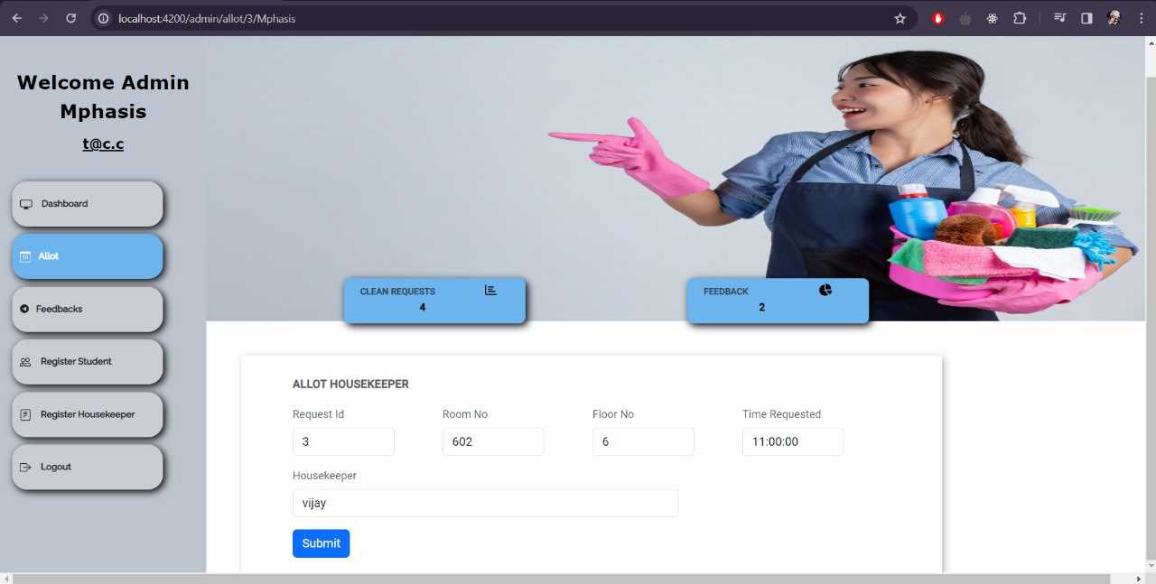
ALLOT HOUSEKEEPER

Slide 26
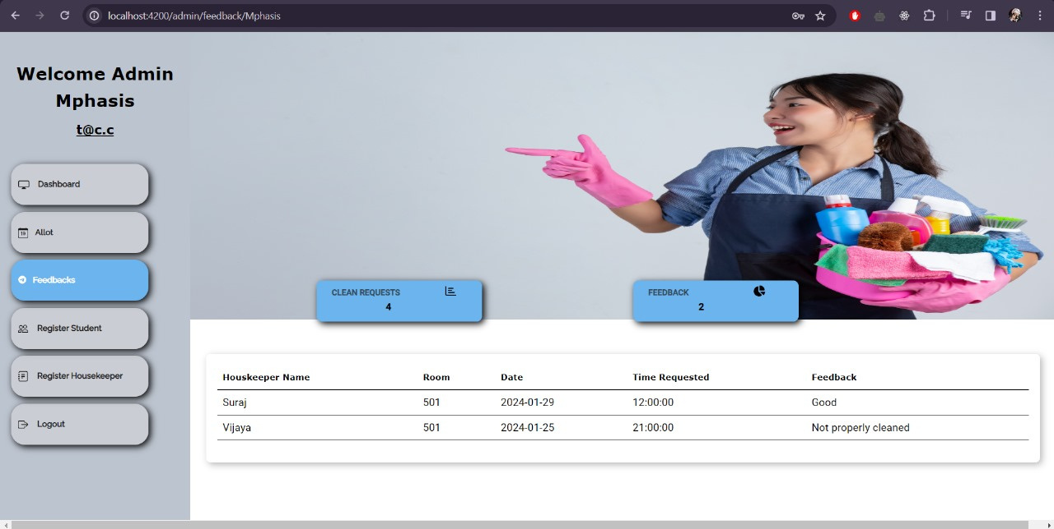
ADMIN FEEDBACK

Slide 27
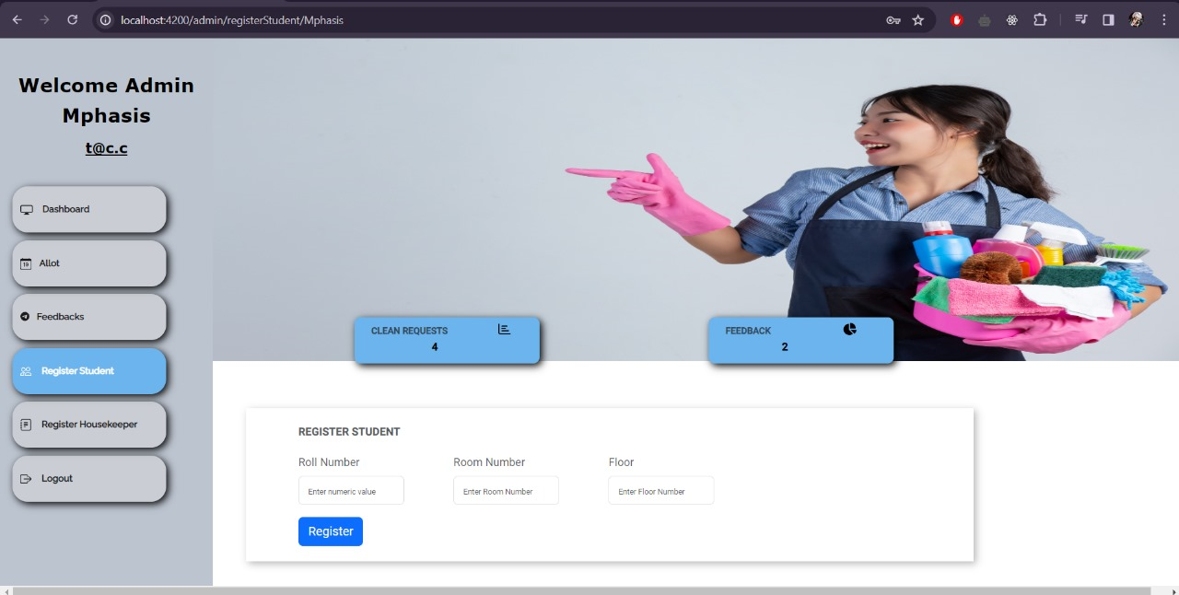
REGISTER STUDENT

Slide 28
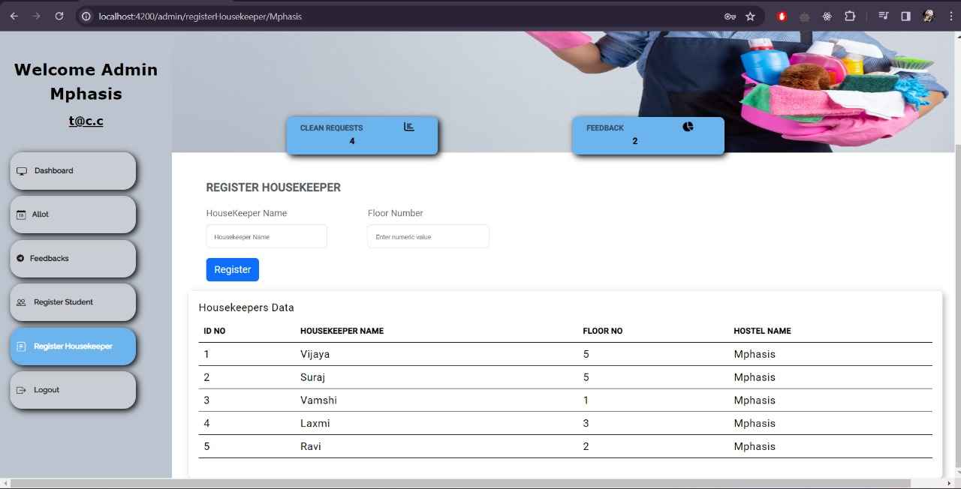
REGISTER HOUSEKEEPER

Slide 29
ADVANTAGES
Effortless Convenience: Easily schedule and manage housekeeping services online, bringing convenience to your doorstep.
Time-Saving: Free up your valuable time by outsourcing housekeeping tasks, allowing you to focus on what matters most to you.
Consistent Quality: Enjoy a consistently high standard of cleanliness with regular and reliable housekeeping services.
Healthy Living Environment: Maintain a healthier living space by eliminating dust, allergens, and bacteria through regular cleaning.
Reduce Errors: Minimizes scheduling mistakes through active tracking.
Enhanced Home Aesthetics: A well-maintained home looks more inviting and aesthetically pleasing, creating a positive atmosphere.

Slide 30
CONCLUSION
Housekeeper Scheduling System is like a helpful assistant for managing cleaning tasks. It makes sure that cleaning happens on time, with the right people and resources.
This tool is easy and simplifies tasks for both administrators and students living in hostels.
This system contributes to a clean and well-maintained environment by improving coordination among housekeeping staff.

Slide 31
THANK YOU

